Slide 1
CodePath
Week 8
CS 4760 F18
Christopher Raley

Slide 2
Homework
Week 8 Lab report 10/28 @ 11:59 PM
Submit on Collab
CodePath Assignment
Submit on Collab and CodePath

Slide 3
Enumeration
Footprining
Fingerprinting
IDOR
XSS
CSRF
Topics
Week 8
Readings on course website

Slide 4
Goals
Building off of last week
More sophisticated attacks
Prerequisites
Vagrant
WPDistillery
Able to access “wpdistillery.vm” on Kali and Host

Slide 5
Vagrant/WP
If you are stuck, remove the current VM you have and start a fresh one
“vagrant destroy --force”
“rm -rf public” <- Need to delete “public” folder
In Windows use “del”
Remember to set version to “4.2” in config.yml file

Slide 6
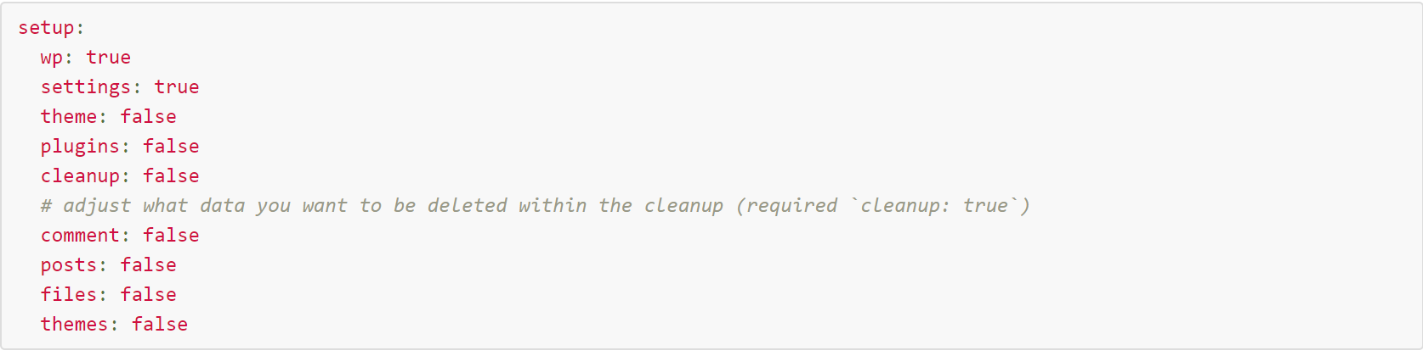
Vagrant/WP

Slide 7
Metasploit
Exploitation framework
On Kali by default
Contains ~1600 exploits for many devices
Many different pre-loaded payloads
Straightforward syntax
You will become familiar with this during the Lab

Slide 8
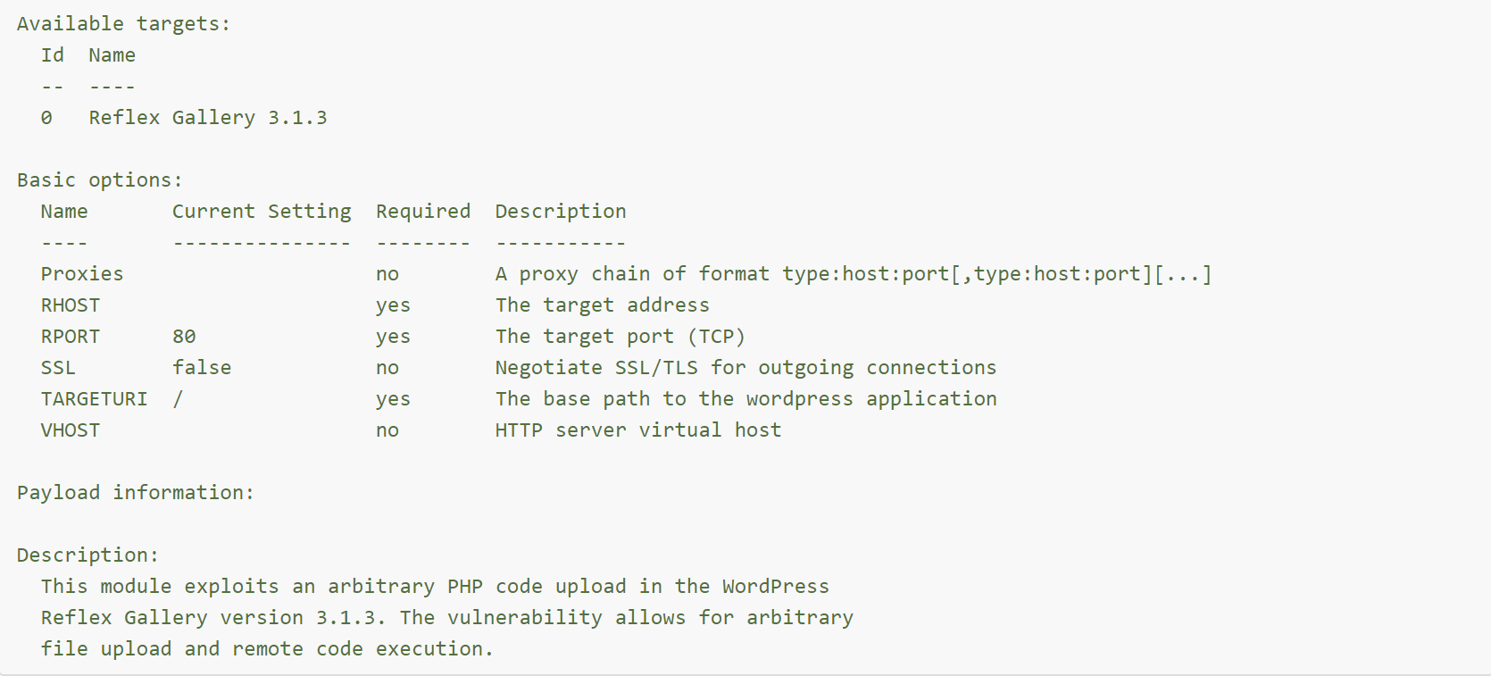
Metasploit

Slide 9
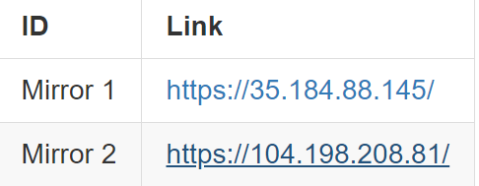
CodePath Assignment
You will be pentesting live targets
There are 3 targets from the link
Red, Blue, Green
Each has 2 vulnerabilities

Slide 10
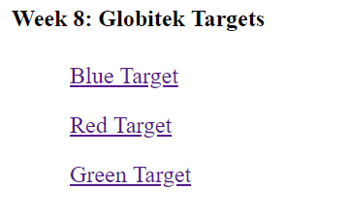

Slide 11

Assignment

Slide 12
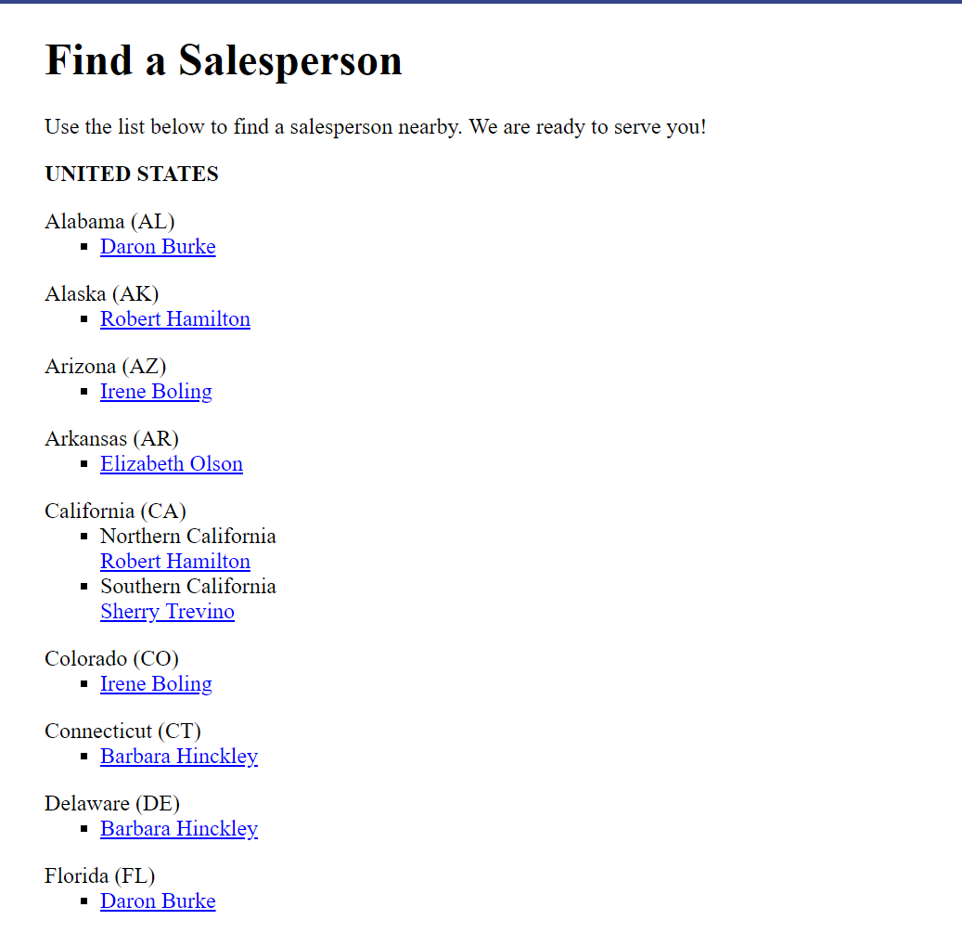

Slide 13
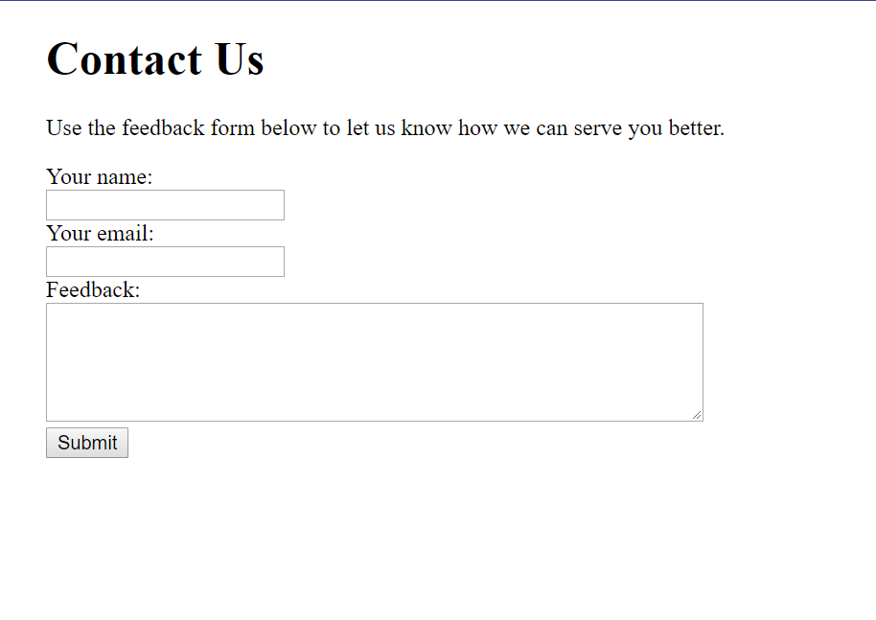

Slide 14
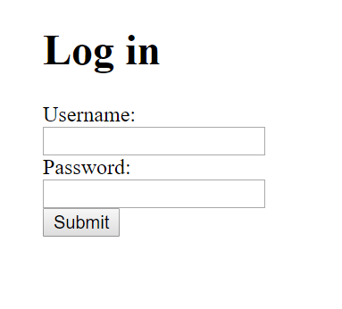
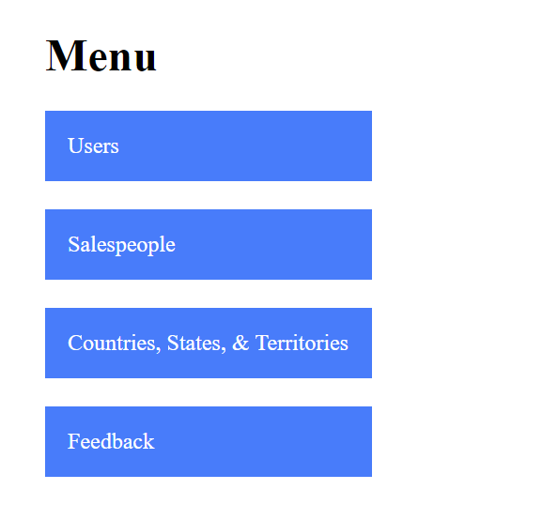

Slide 15
CodePath Assignment
Each website looks identical (besides the color)
However, they each have 2 different vulnerabilities
Overall you need the carry out the following in total:
User enumeration
IDOR
SQLi
XSS
CSRF
Session Hijacking/Fixation

Slide 16
Setup Notes
This week we are going to use Kali to attack WordPress
In order to do this we will place Kali and WordPress in the same network, so that they can communicate with each other
The next couple of slides will show the changes in the VM settings (full walkthrough on CodePath)

Slide 17
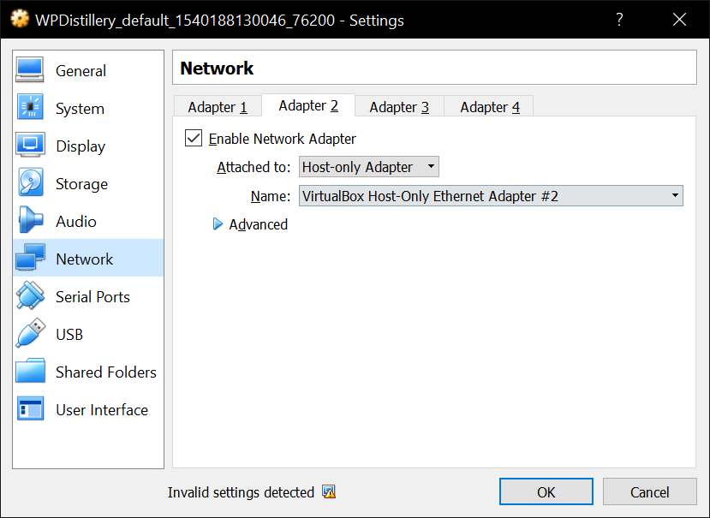
Setup Notes
Determining the host adapter of the VM
Doesn’t have to have the name “vboxnet3” like they have in the directions

Slide 18
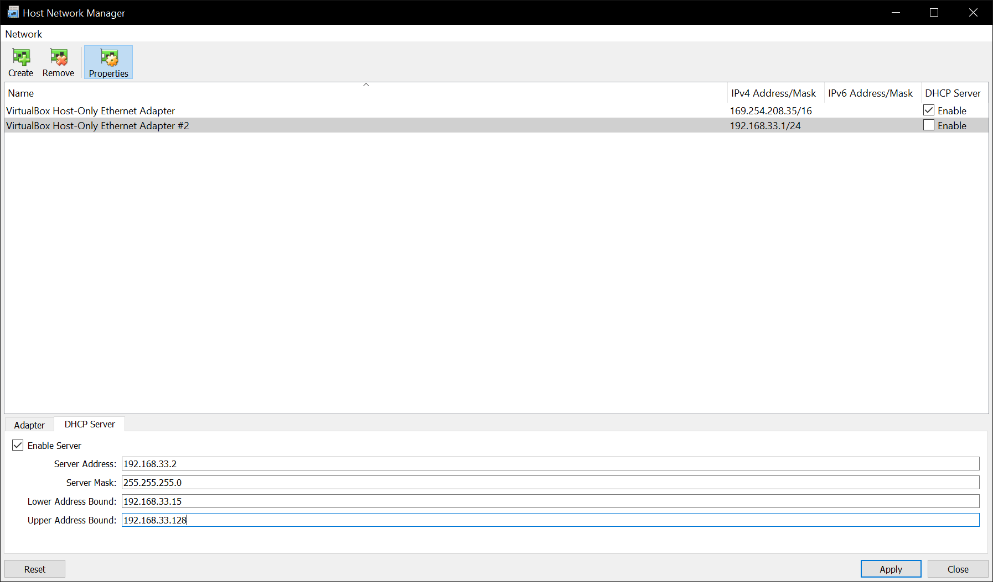
Setup Notes
In VirtualBox go to:
File -> Host Network Manager
Make sure “Enable Server” in DHCP is checked

Slide 19
Setup Notes
Values in “DHCP Server” tab should match up with CodePath directions

Slide 20
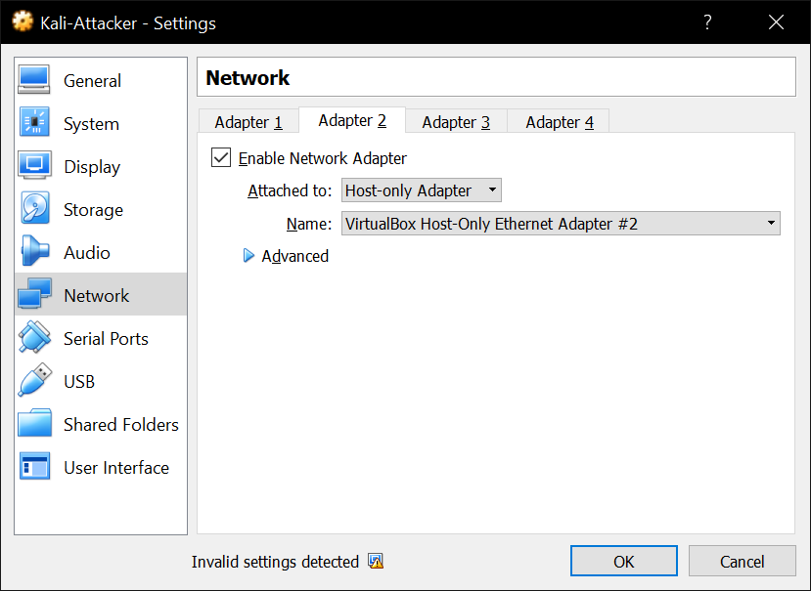
Setup Notes
Go to Network settings for Kali-Attacker and set the second adapter as shown in the image

Slide 21
Setup Notes
“VirtualBox Host-Only Ethernet Adapter #2” should be whatever the WPDistillery VM was using for their second adapter

Slide 22
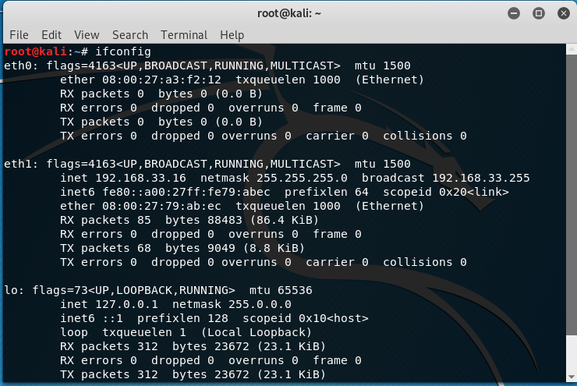
Setup Notes
This should appear in Kali if everything was setup correctly
Important part is the “inet” value

Slide 23
Important Notes
Necessary to read through everything on the CodePath website carefully
Start early, some of you will encounter technical difficulties
Windows users must run everything as an administrator
Document as you go
In case you make a mistake

Slide 24
Important Notes
If you plan on using the course’s copy of Kali…
You need to run: apt-key adv --keyserver hkp://keys.gnupg.net --recv-keys 7D8D0BF6

Slide 25
Important Notes
If you plan on using the course’s copy of Kali…
apt-get update && apt-get upgrade
This will take some time
https://guides.codepath.com/websecurity/Running-Kali-Linux-in-VirtualBox

Slide 26
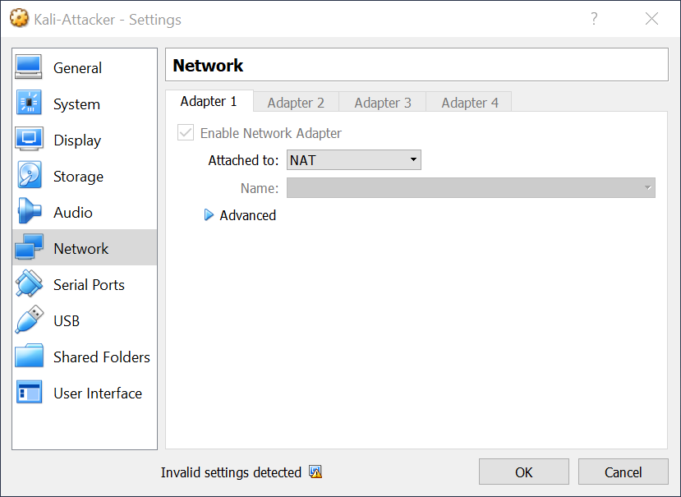
Important Notes
If you plan on using the course’s copy of Kali…

Slide 27
Important Notes
Kali by default already this installed, so you should be able to run all commands listed in the Lab with no problems

Slide 28
Lab Report
Walkthrough of Milestone 5/6 in the Lab and the Assignment as well
View rubric on Collab for details
Make sure to submit a PDF in the format as described in the write-up
Try and solve all technical issues you encounter (make sure to document these)

Slide 29
CodePath Assignment Submission
Following the submission guidelines
https://courses.codepath.com/courses/cybersecurity_university/pages/submitting_assignments
You need to create a public repo with your GitHub account you used to sign up for CodePath
Read all directions/requirements carefully

Slide 30
Office Hours
Monday / Thursday / Sunday : 5 - 7 PM @ Rice 226

